Slide 1
Can we create an object without using new operator in Java?
momedaram

Slide 2
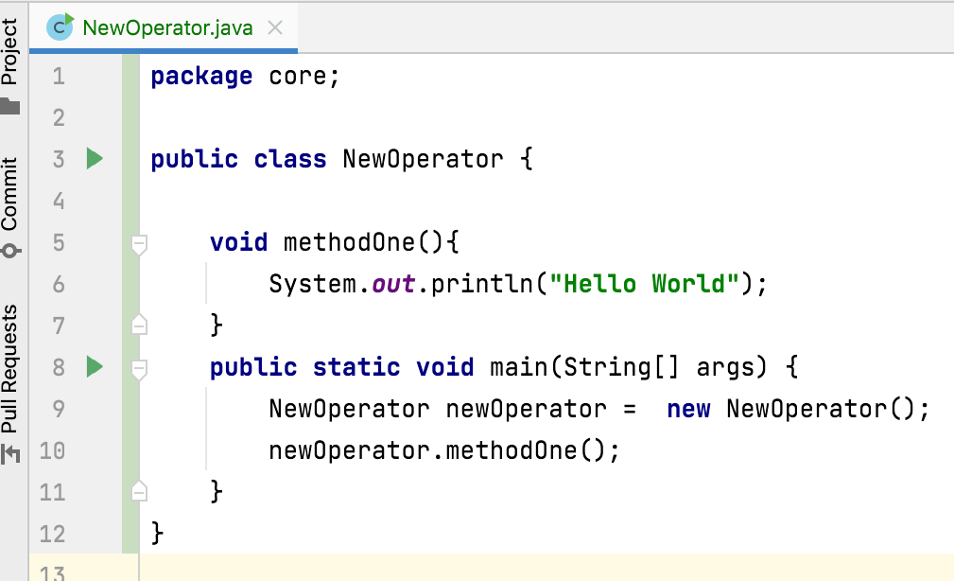
95% of objects created by using new operator in java

Slide 3
Can we create an object without using new operator in Java?

Slide 4
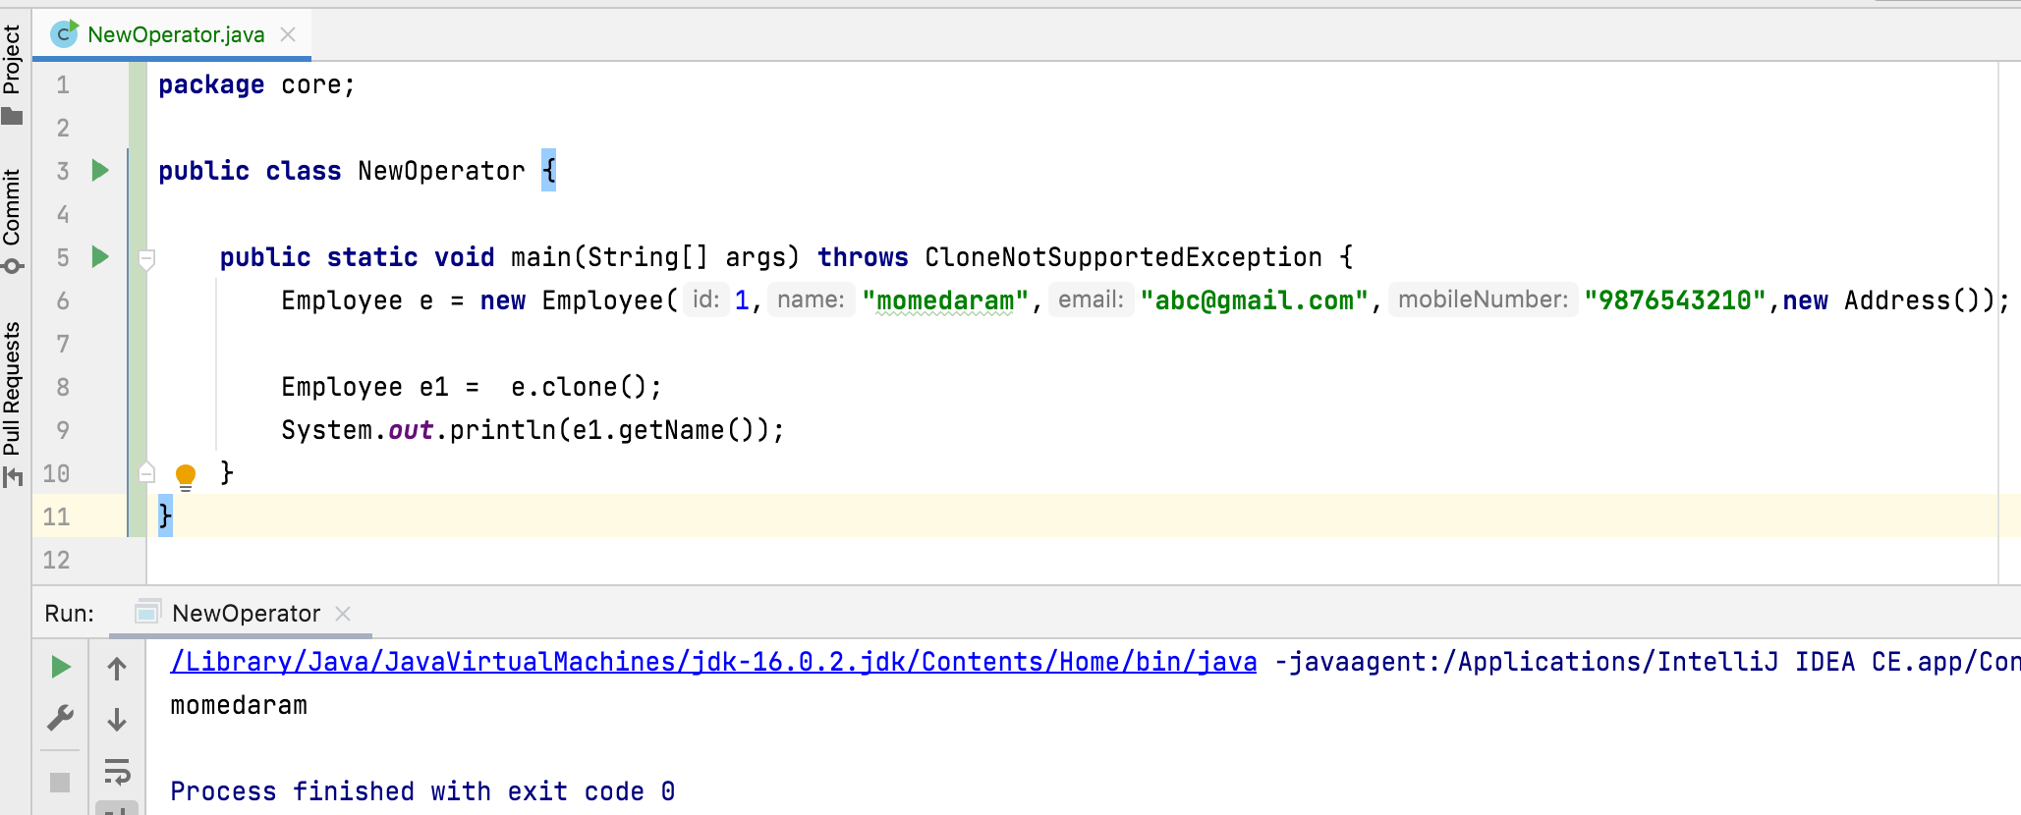
A) clone() – create an exact copy of an object

Slide 5
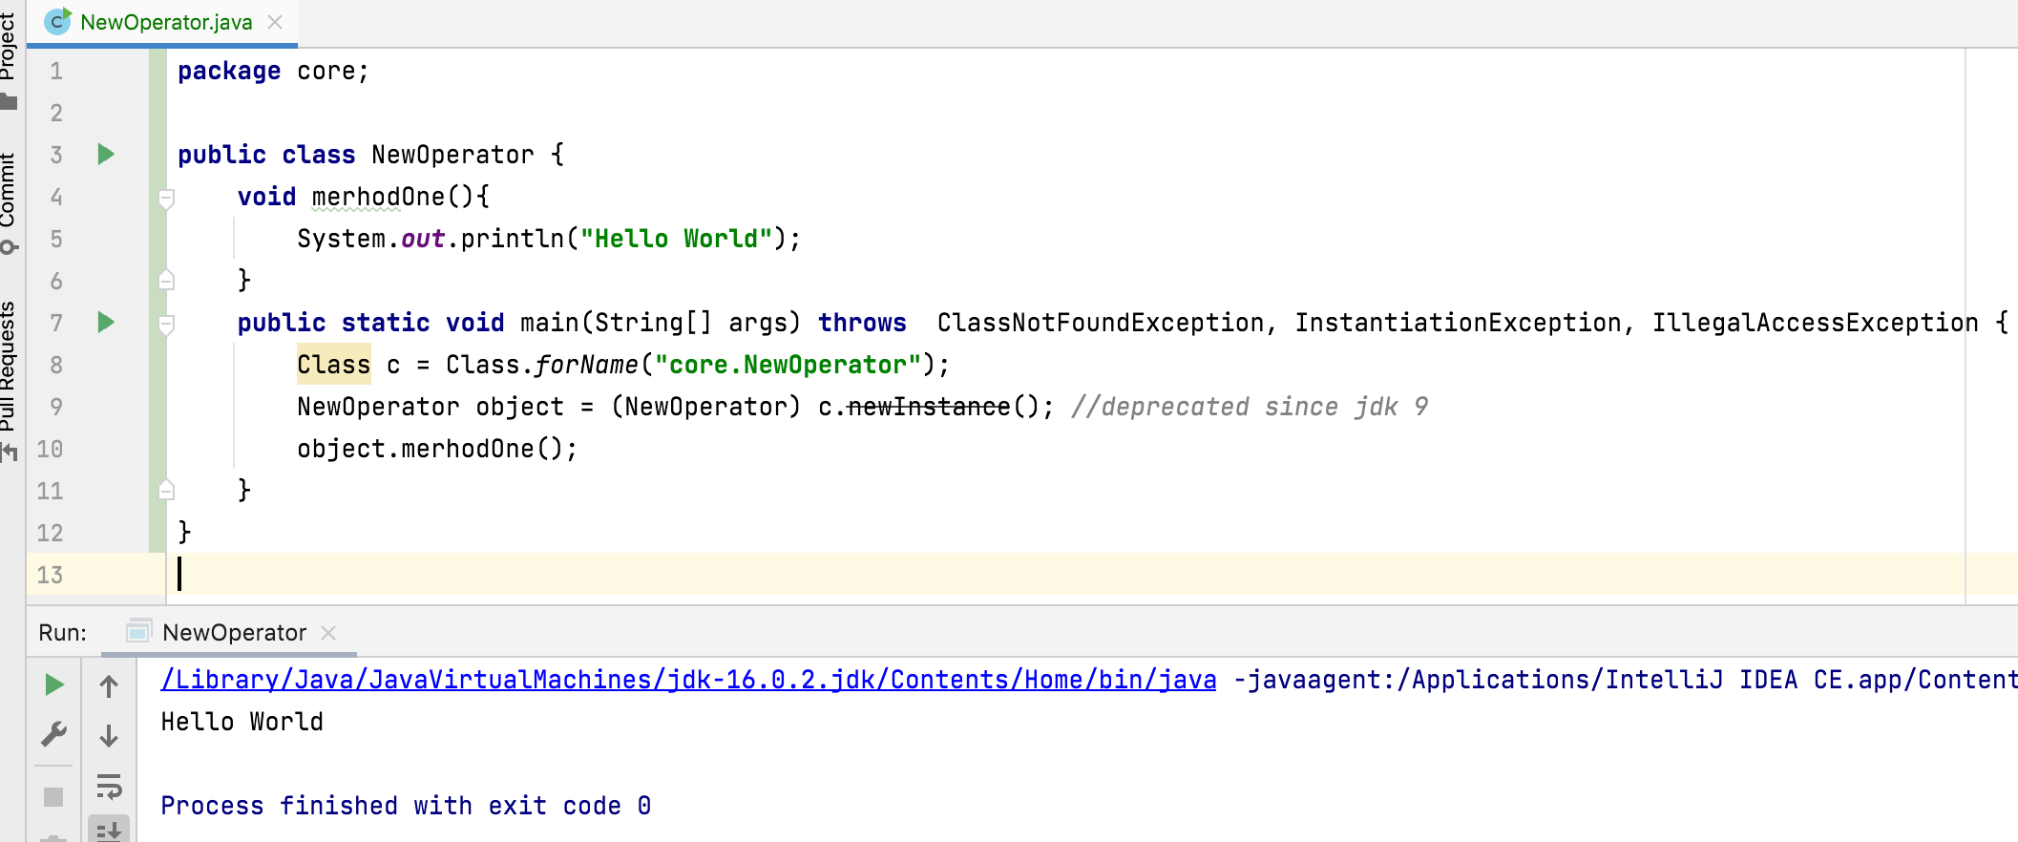
B) newInstance()
Creates a new instance of the class represented by this Class object.

Slide 6
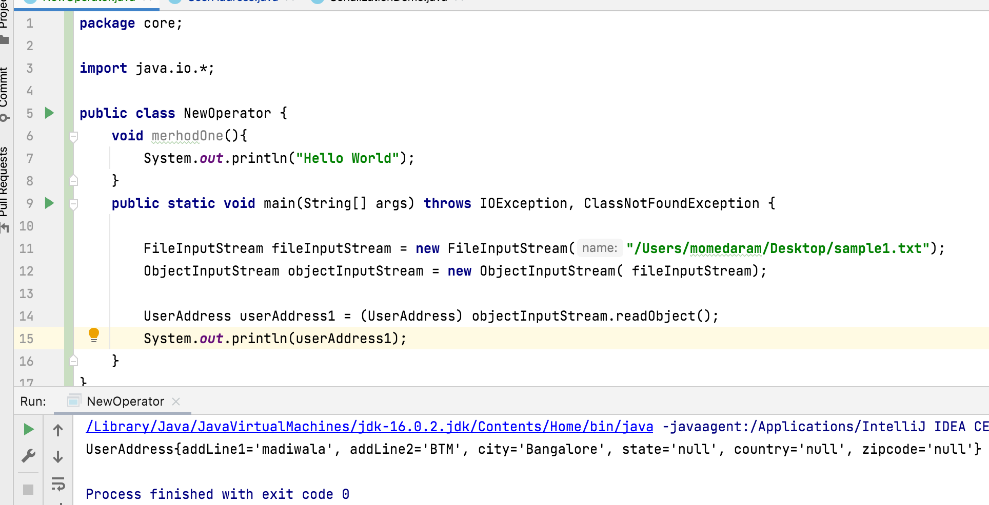
C) Object deserialization

Slide 7
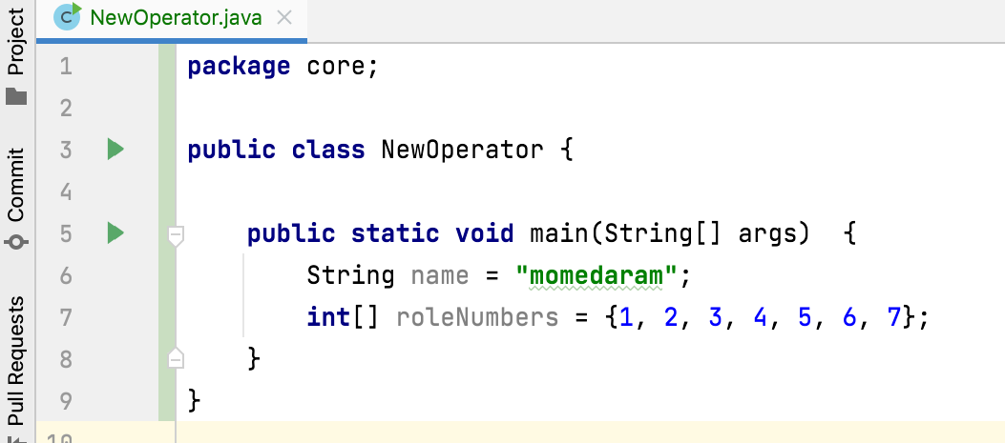
D) String and array objects

Slide 8

Thank You!
momedaram

